Slide 1


2023
developped by :
Maryame BADDOU
Mario Abel ARDUZ CAMPERO
Javier Antonio PARES BARBERENA
Roberto Ernesto Chavez

Slide 2

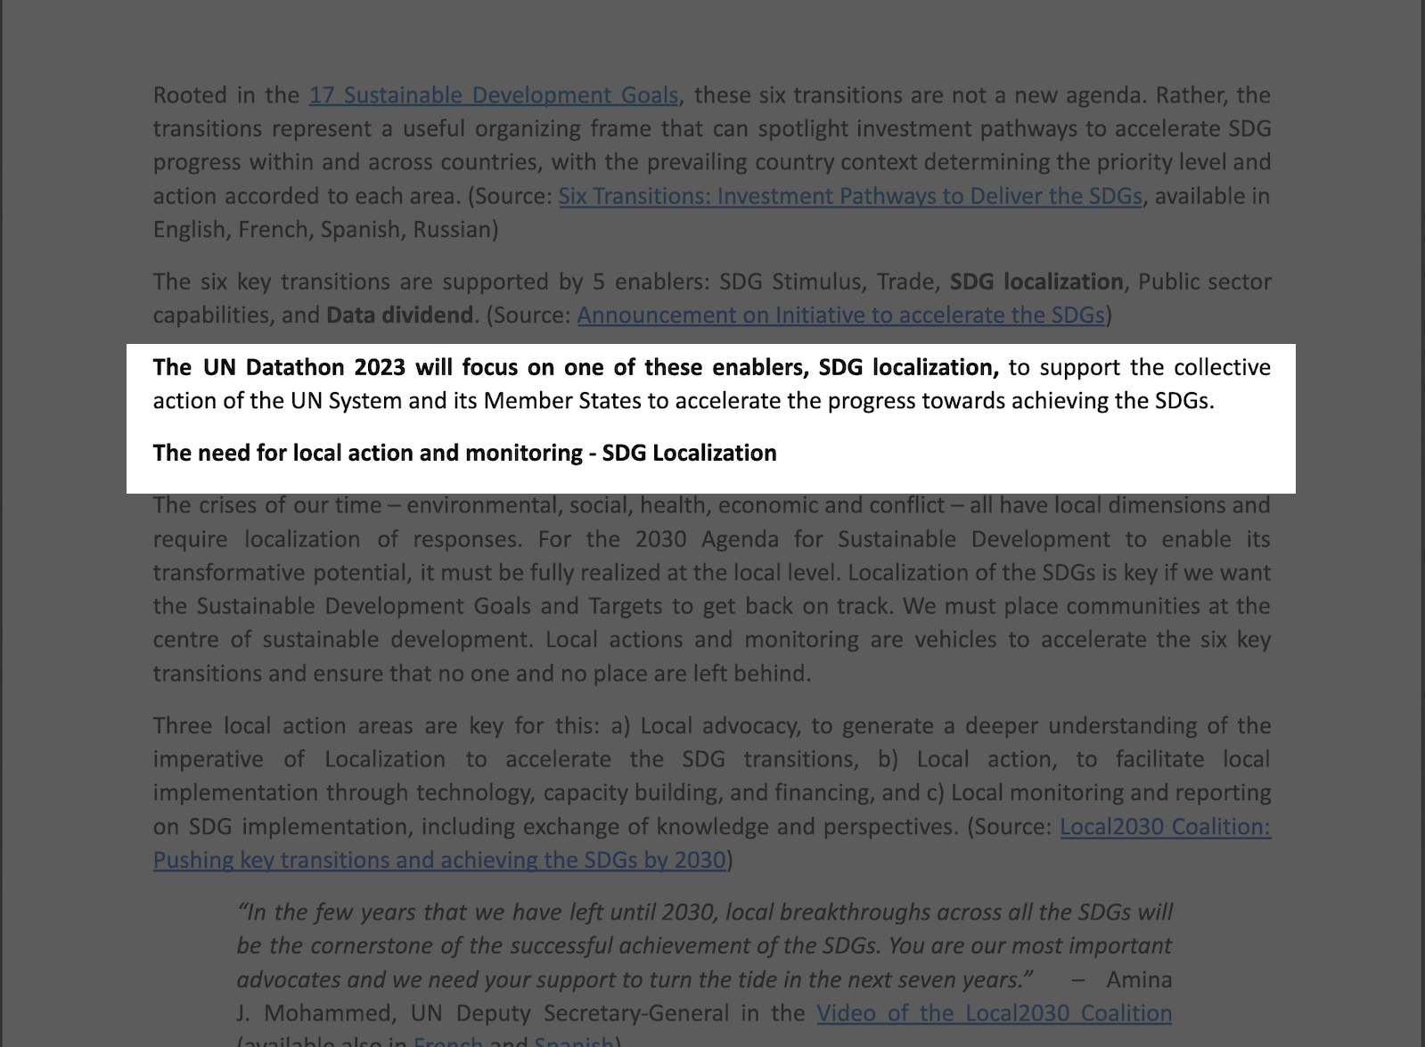
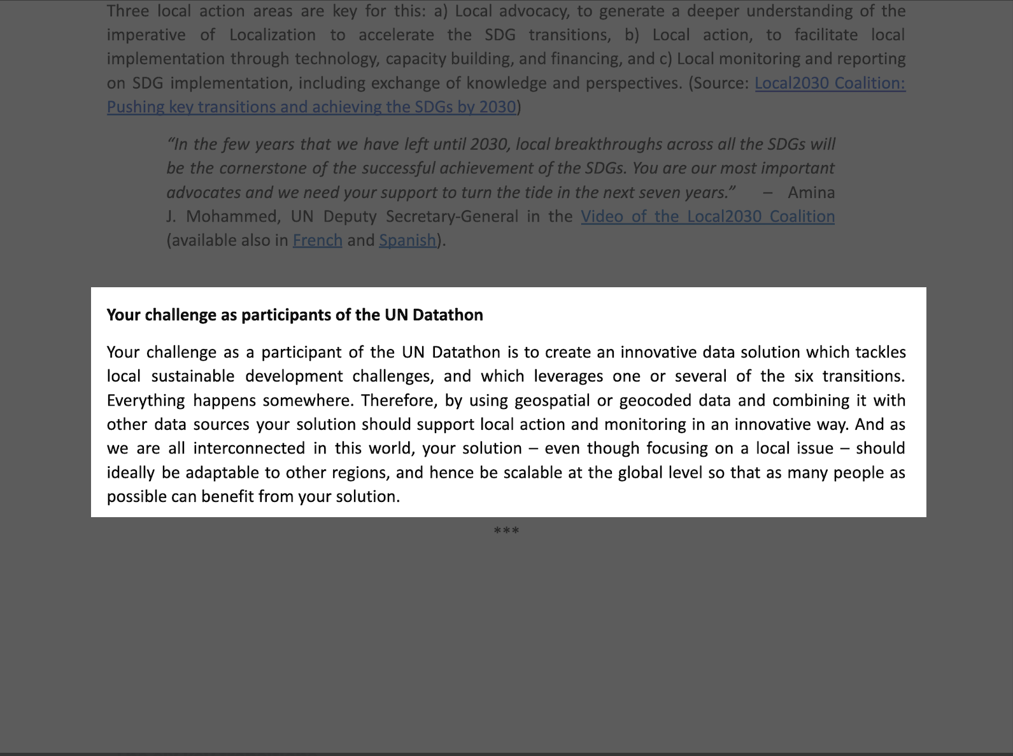
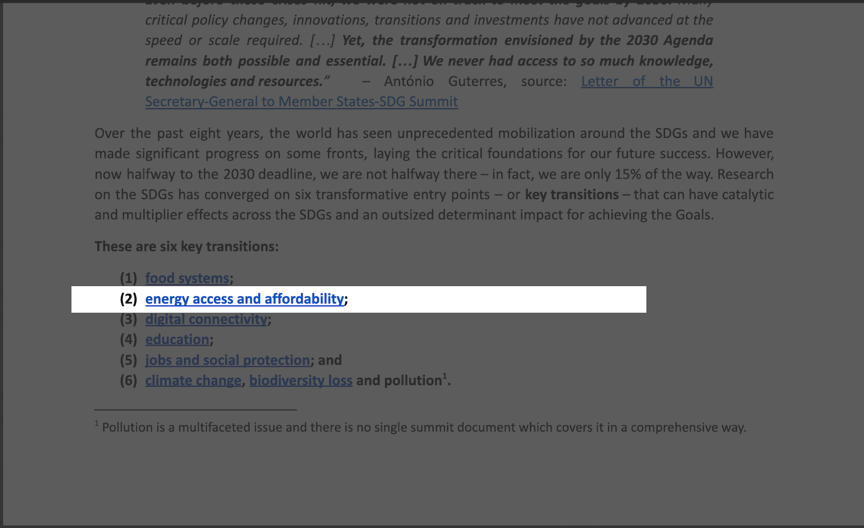
General Scope of our participation

Slide 3
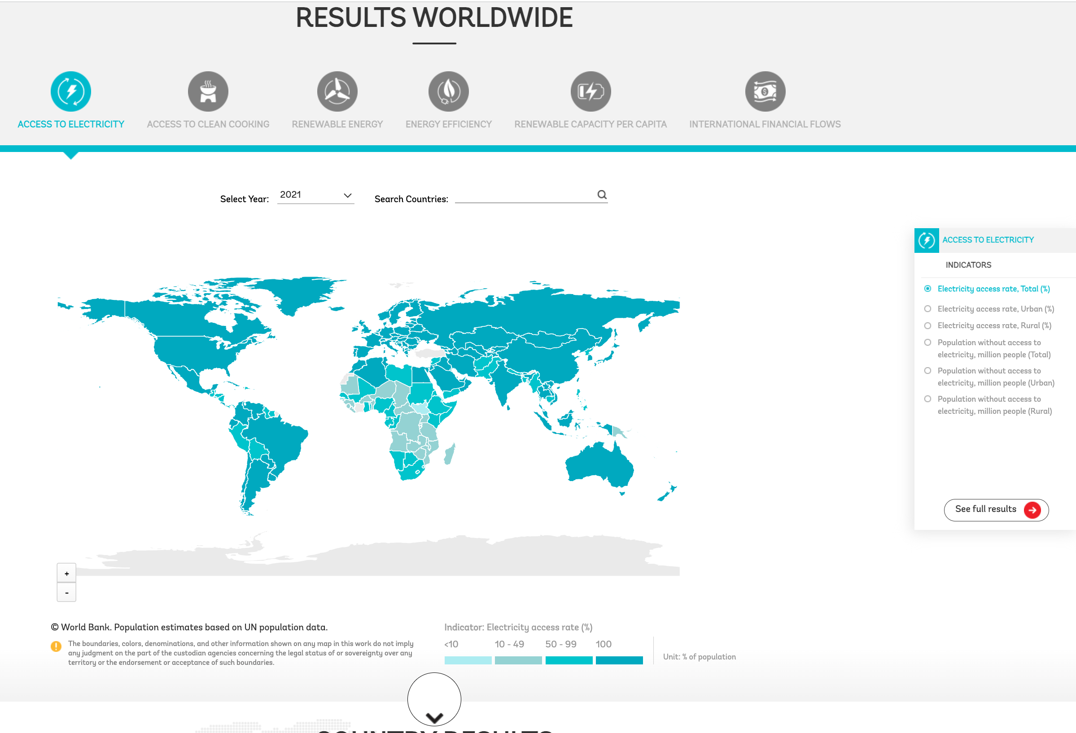
Context 2.0 : up to day monitoring

Slide 4
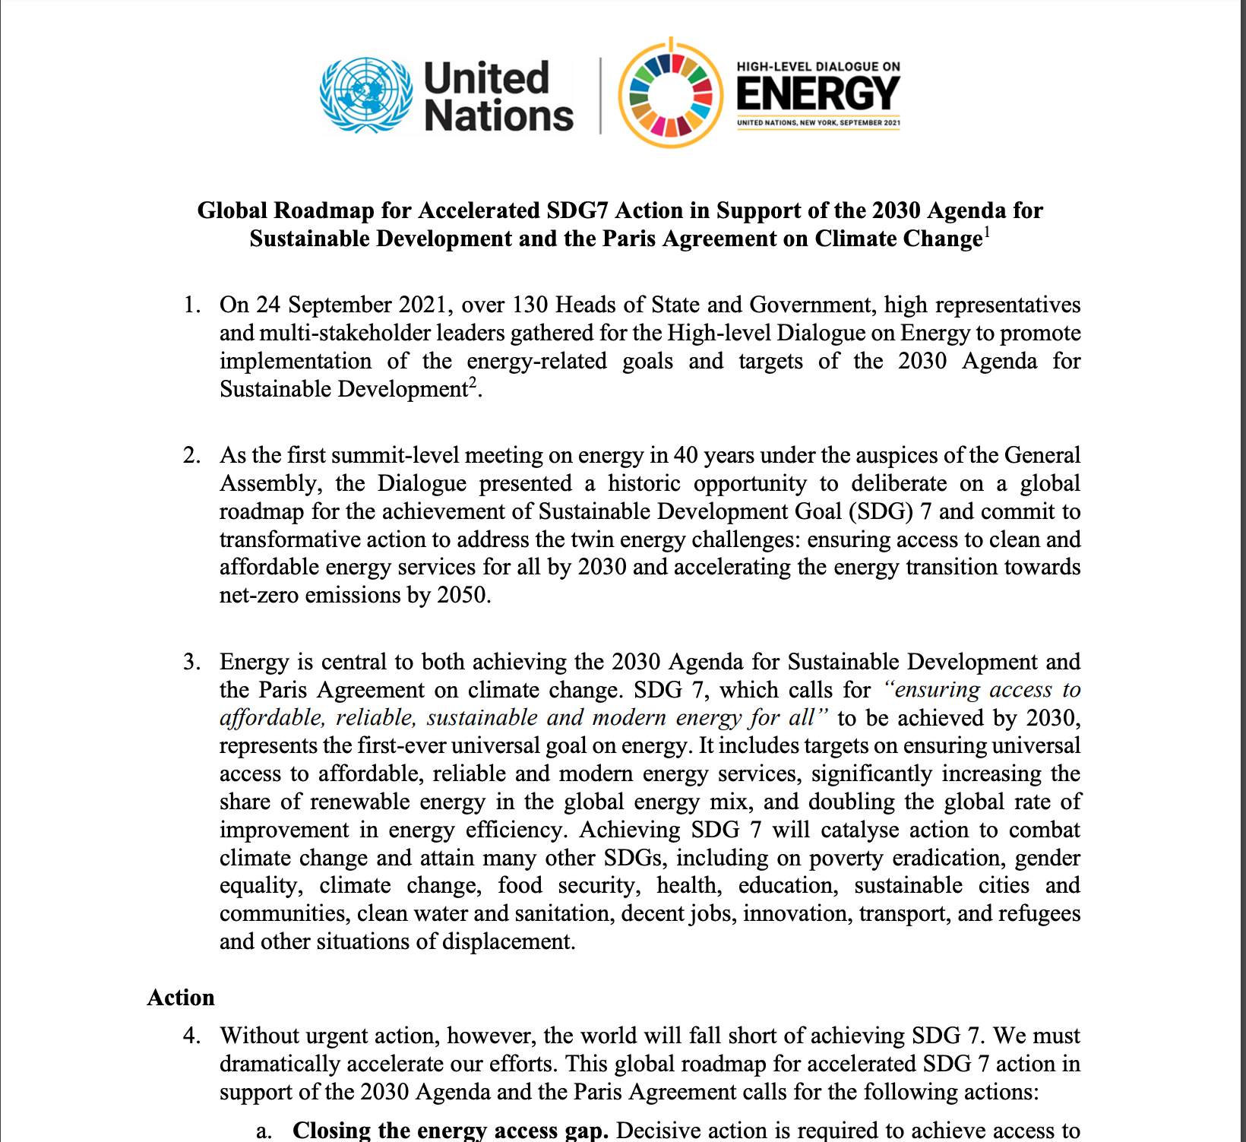



Context 2.1 Roadmaps, milestones, annual meetings

Slide 5

Context 2.2 Retrospective approach for better action
Up to day data
Scalable application (local, regional, national, international)
Big vision, little detail
Focus on SDG7.1.1
Targets

Slide 6
Results
https://undatathon.maps.arcgis.com/apps/mapviewer/index.html?webmap=798b5899515b423d82a588d6045bbd4b
https://github.com/equipounopsNICARAGUA/2030-SEER

